Slide 1
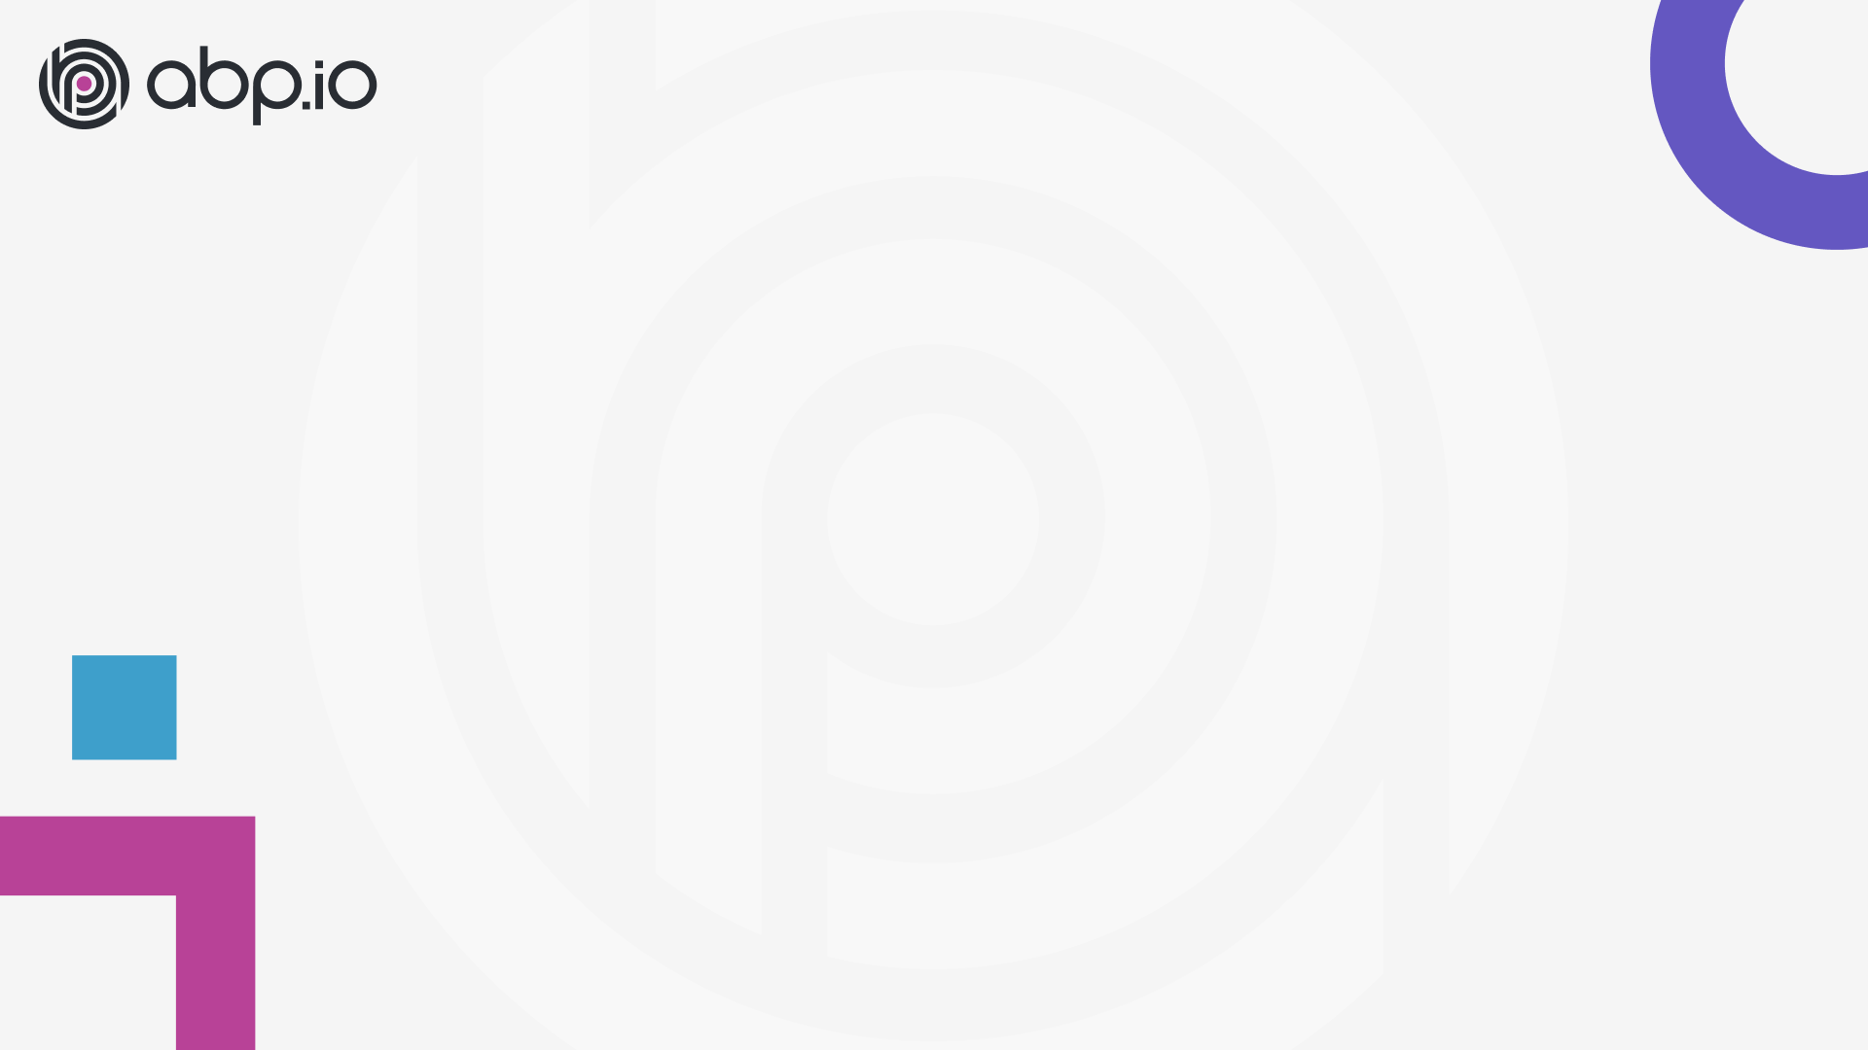
ABP Community Talks 2022.5
MAUI & ABP Framework

Slide 2
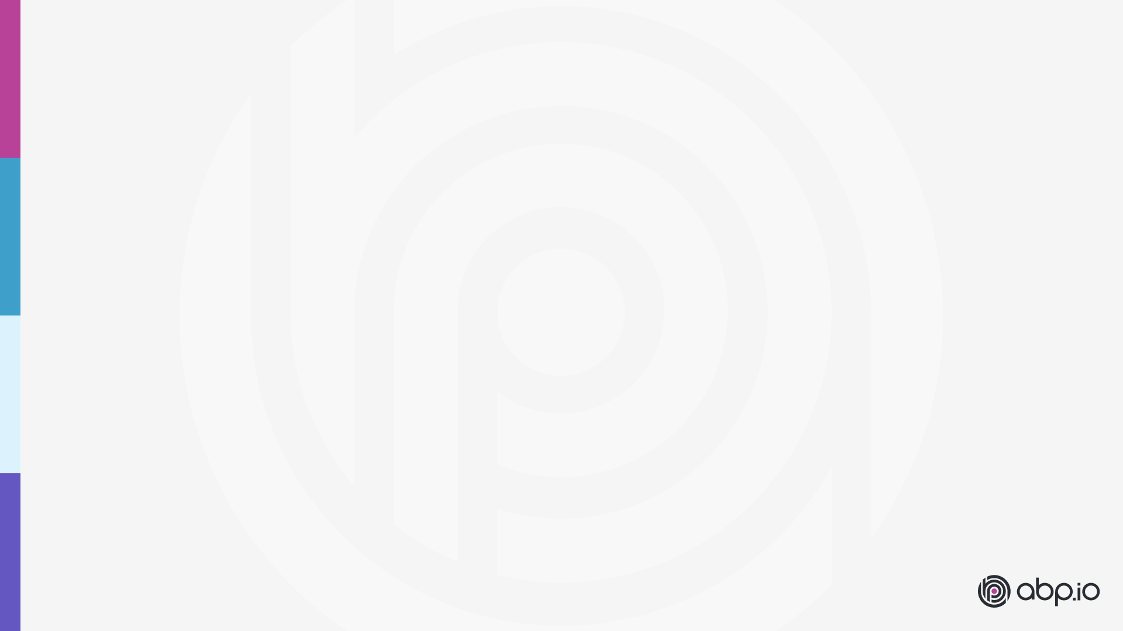
Agenda
ABP news / Halil İbrahim Kalkan
Presentation: What is MAUI? / Alper Ebiçoğlu
Demo: MAU (with Blazor) & ABP / Enis Necipoğlu
Discussions & Questions

Slide 3
ABP v5.3.0 June 14, 2022
What’s new with this version?

Slide 4
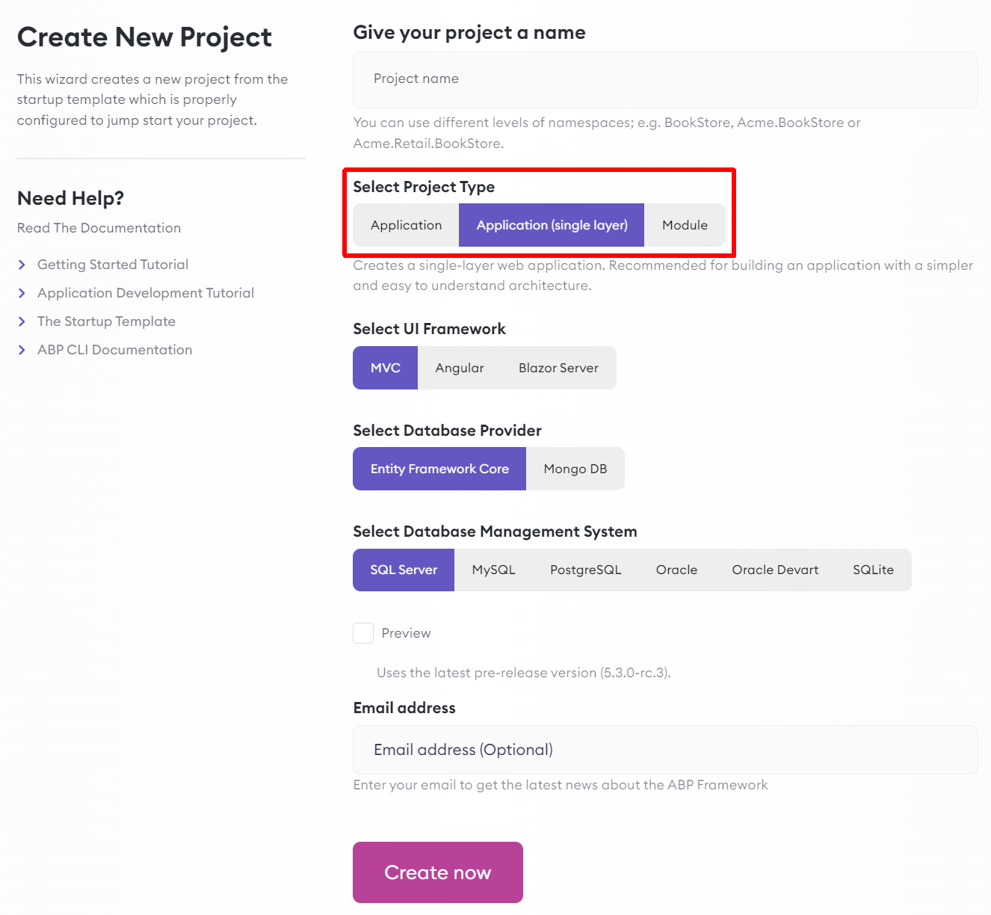
Single-Layer Solution Template
Download from:
https://abp.io/get-started
Use ABP CLI: abp new TodoApp -t app-nolayers
Quick Start: https://docs.abp.io/en/abp/5.3/Tutorials/Todo/Single-Layer/Index
Solution structure: https://docs.abp.io/en/abp/5.3/Startup-Templates/Application-Single-Layer

Slide 5
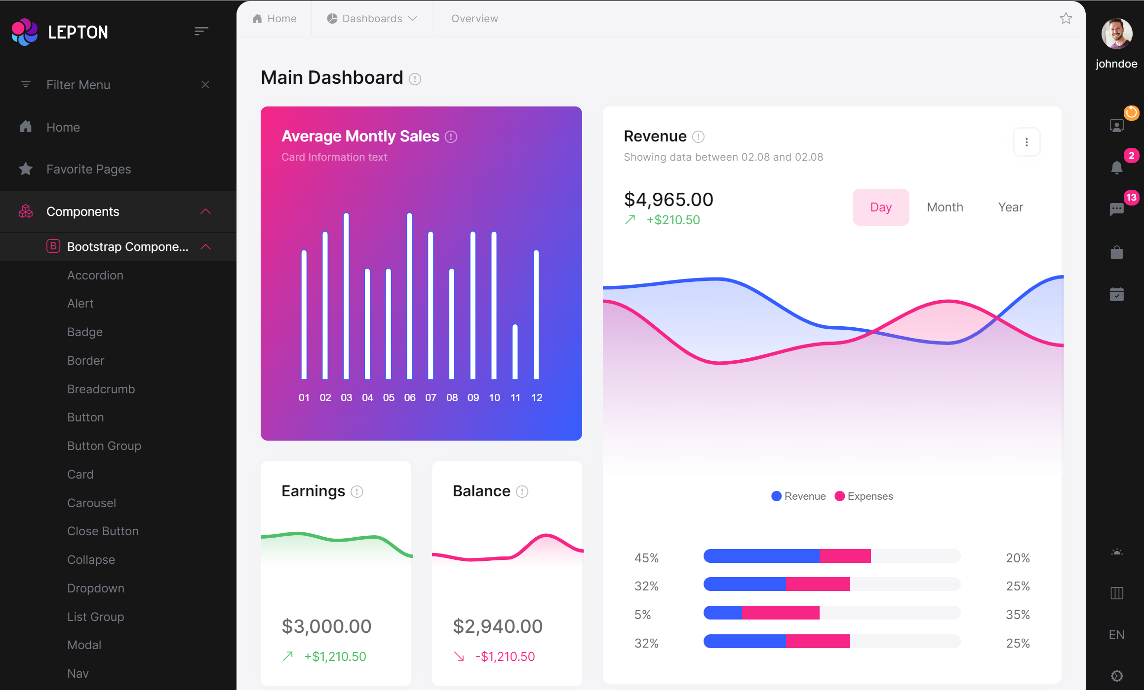
LeptonX theme v1.0 beta https://x.leptontheme.com

Slide 6
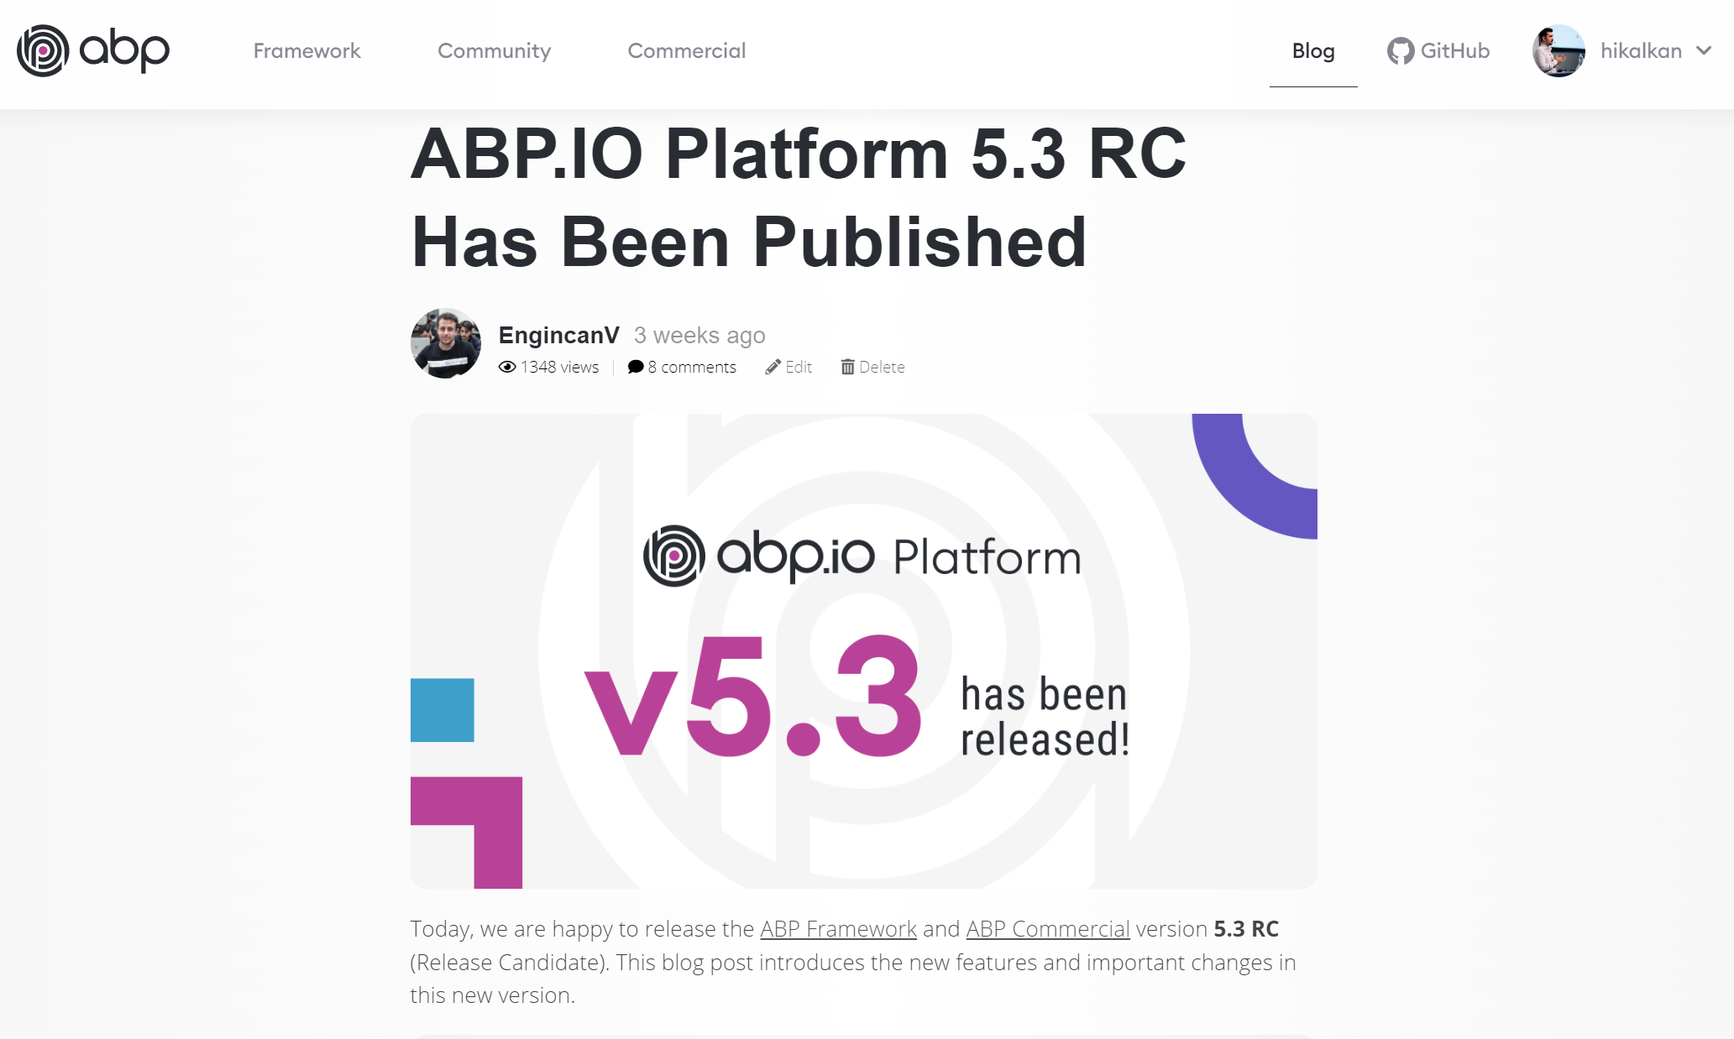
https://blog.abp.io

Slide 7
ABP Release Schedule
6.0 RC (July, 2022)
OpenIddict, LeptonX (default), Simple MAUI startup template
6.0 Stable (August, 2022)
7.0 RC (November, 2022)
Based on .NET 7.0
7.0 Stable (December, 2022)
7.1, 7.2… etc.

Slide 8
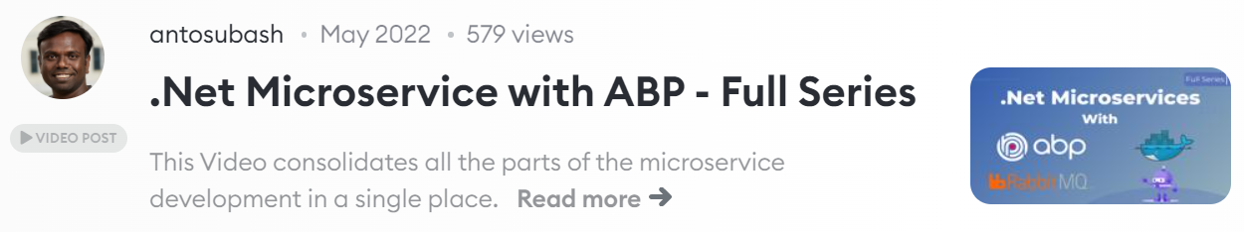
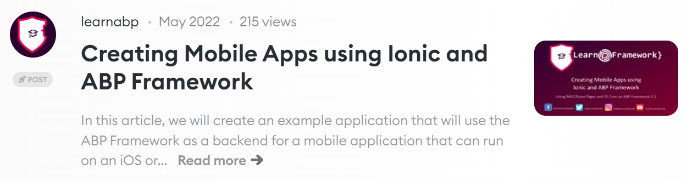
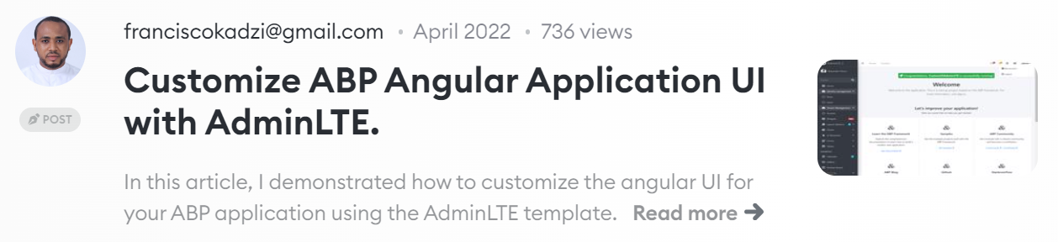
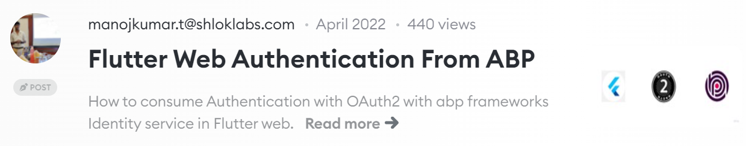
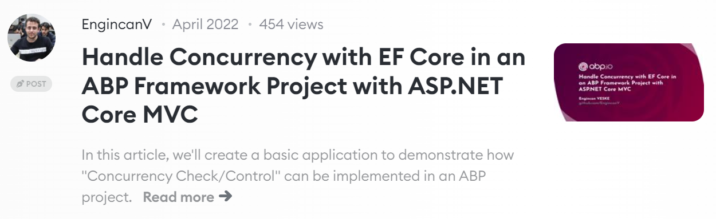
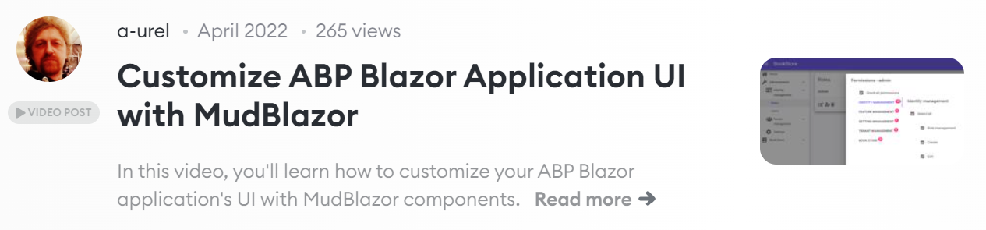
ABP Community posts https://community.abp.io
https://community.abp.io/posts/submit

Slide 9





The ABP Community
GitHub: Bug reports, feature requests & discussions http://github.com/abpframework
StackOverflow: Questions https://stackoverflow.com/questions/tagged/abp
Discord: Any kind of interaction https://discord.gg/abp
Twitter: Follow for the latest news from ABP http://twitter.com/abpframework
YouTube: Video tutorials and live events https://www.youtube.com/c/Volosoft

